Slide 1





Training Day – Module 2B
Regional energy market integration
Ignacio Pérez-Arriaga
Florence School of Regulation
African School of Regulation
Presentation Title
Text Day/Month/2026
21/September/2026

Slide 2
Outline
The benefits of cross-border trade / regional markets
Does integration need markets?
Markets facilitate advanced multinational integration
Issues to be addressed in the design and implementation of regional electricity markets
  mmm
Market design
Governance
Capacity expansion
Transmission network utilization and system operation

Slide 3
Outline
The benefits of cross-border trade / regional markets
Does integration need markets?
Markets facilitate advanced multinational integration
Issues to be addressed in the design and implementation of regional electricity markets
  mmm
Market design
Governance
Capacity expansion
Transmission network utilization and system operation

Slide 4


The benefits of cross-border trade/ regional markets
Reduction in the total costs of meeting demand, by using a larger pool of resources
  In the EU, market integration reduced total cost of serving demand by EUR 34 bn in 2021 alone, compared to separate national markets (source ACER)
A larger (interconnected) system is more stable
Reduction in the total costs of providing reserve, as resources could be shared and the reserve needs are proportionately lower for larger systems
Easier integration of variable renewable-based generation
An instrument and consequence of political integration.

Slide 5

Because of the well-known advantages of integration, utilities, states and countries have coordinated at various levels their power systems worldwide

Slide 6
Outline
The benefits of cross-border trade / regional markets
Does integration need markets?
Markets facilitate advanced multinational integration
Issues to be addressed in the design and implementation of regional electricity markets
  mmm
Market design
Governance
Capacity expansion
Transmission network utilization and system operation

Slide 7
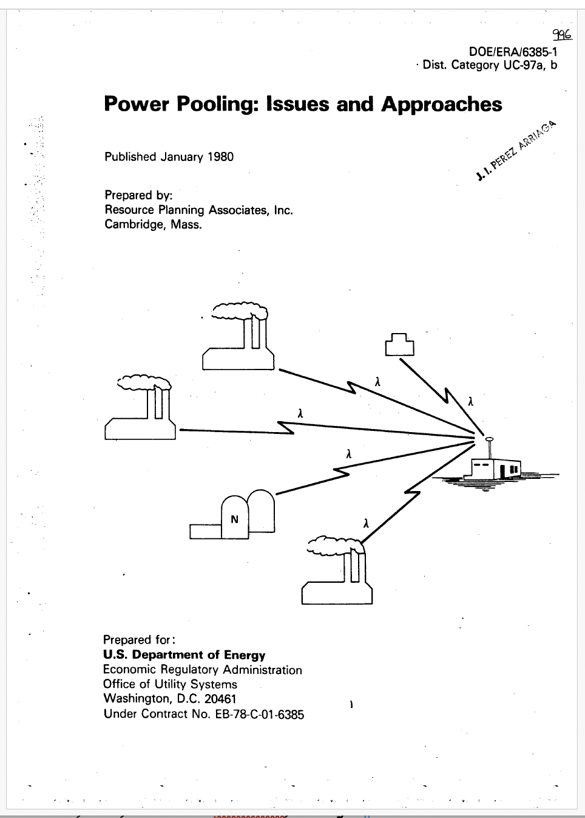
Notes:
xxx

Slide 8
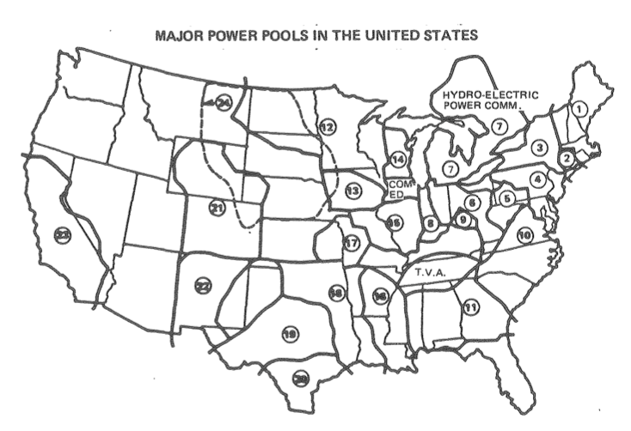
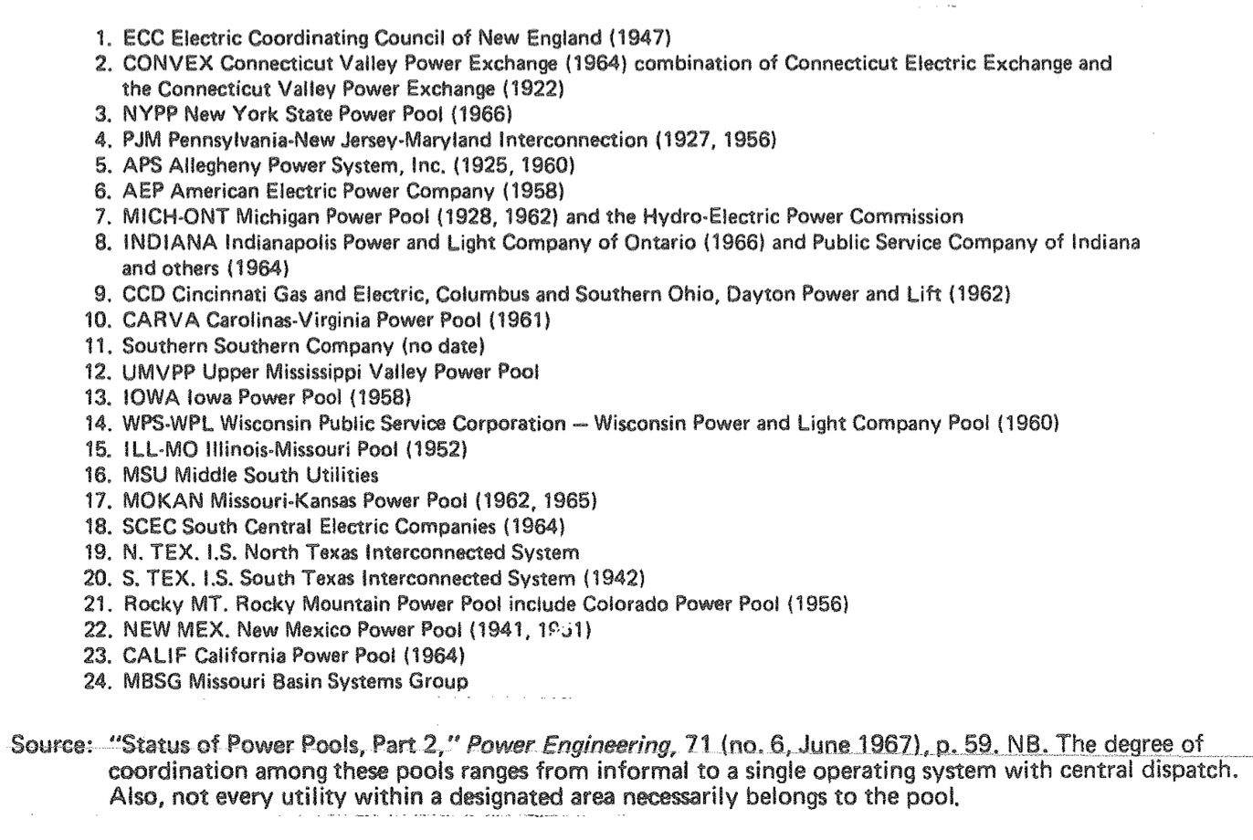
Major power pools in the USA – 1967
(various levels of centralised operation & capacity expansion)
https://escholarship.org/content/qt6z726421/qt6z726421.pdf?utm_source=chatgpt.com

Slide 9
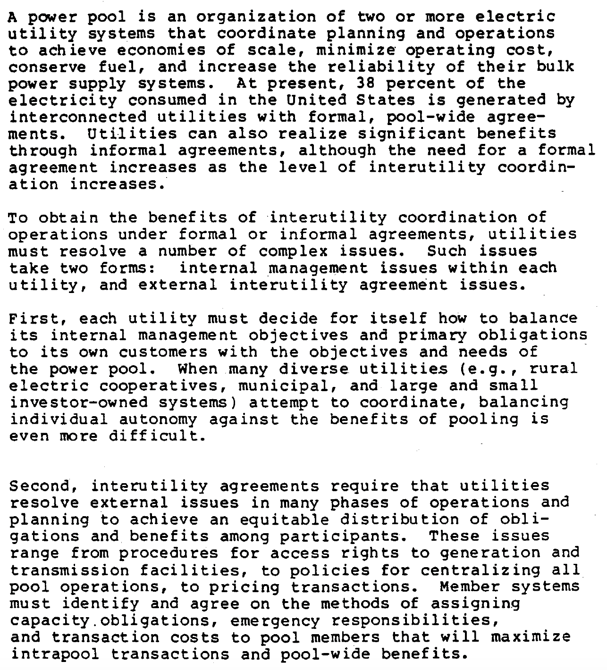
Notes:
xxx

Slide 10
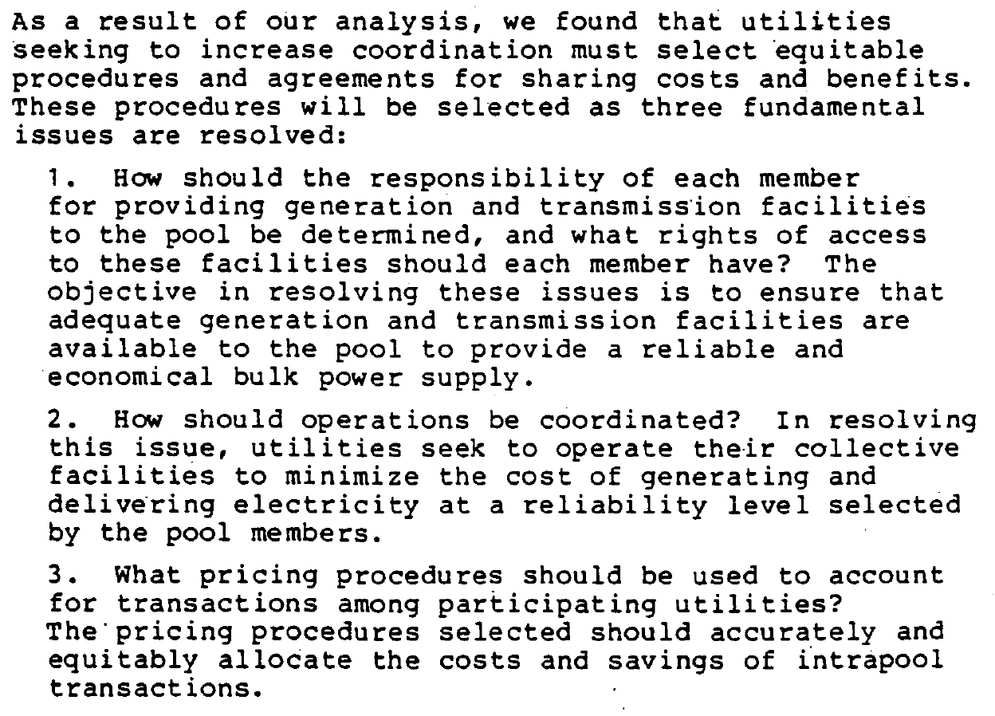

Slide 11
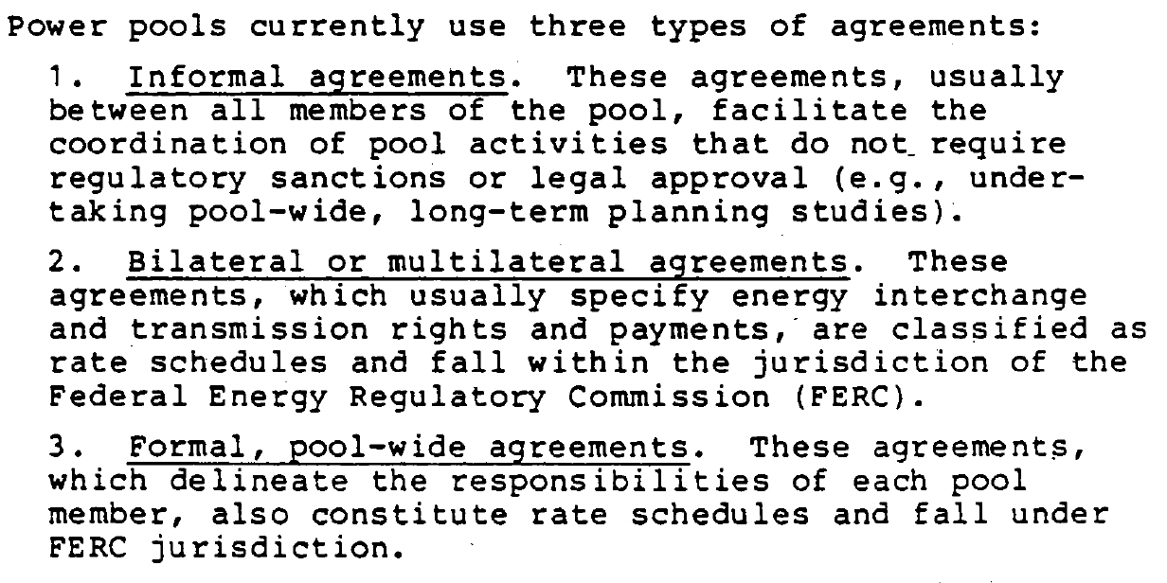

Slide 12
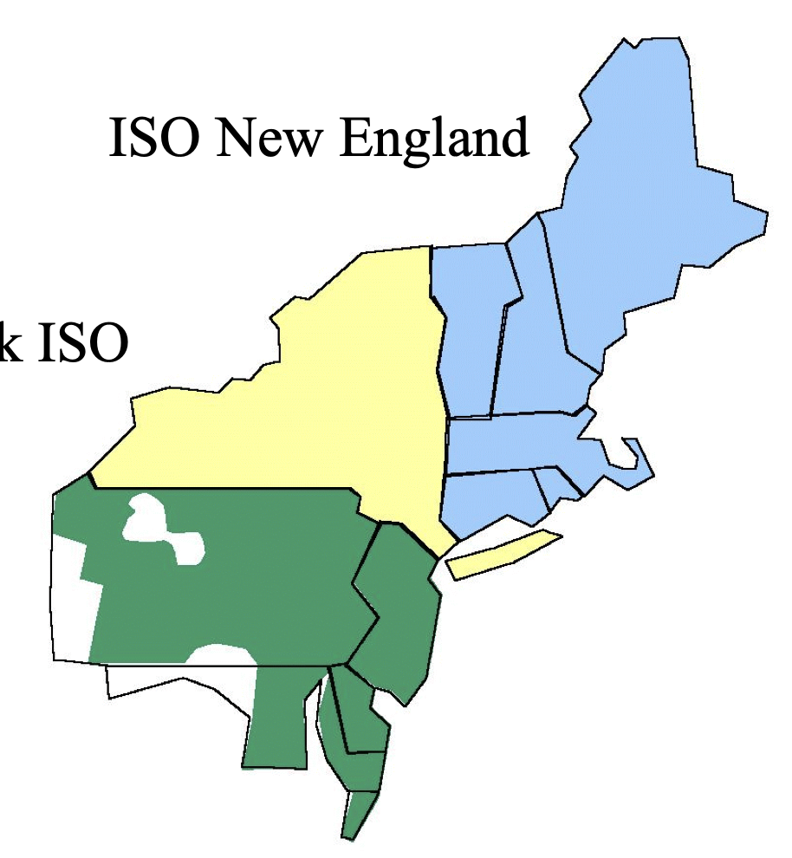
Further level of aggregation & coordination in the Northeast USA
1971 - 1996
NEEPOOL
New England Power Pool
NYPP
New York Power Pool
PJM
Pennsylvania, New Jersey & Maryland interconnection
https://www.ferc.gov/sites/default/files/2020-05/northeast.PDF?utm_source=chatgpt.com

Slide 13
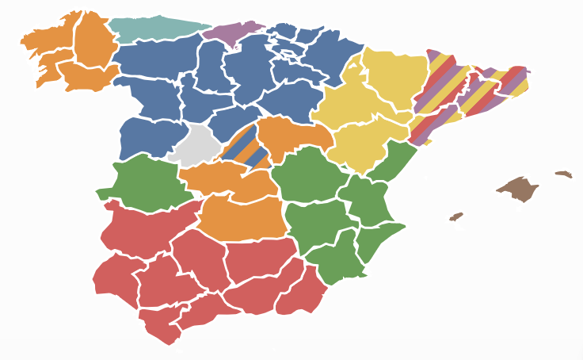

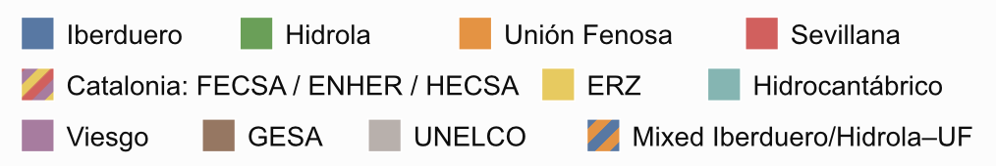
Utility members of the Spanish Power Pool – 1984
(created in 1984; evolved until liberalisation in 1998; first national power pool in the world)
CANARY ISLANDS

Slide 14
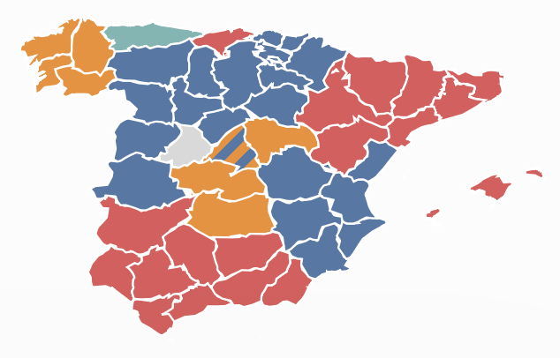

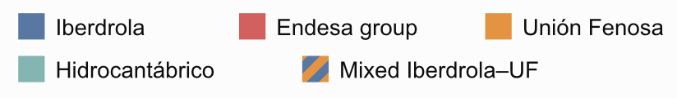
Utility members of the Spanish Power Pool – 1998
(created in 1984; evolved until liberalisation in 1998; first national power pool in the world)
CANARY ISLANDS

Slide 15
Outline
The benefits of cross-border trade / regional markets
Does integration need markets?
Markets facilitate advanced multinational integration
Issues to be addressed in the design and implementation of regional electricity markets
  mmm
Market design
Governance
Capacity expansion
Transmission network utilization and system operation

Slide 16
Integration hits political & harmonisation limits when tried at multinational level

Slide 17
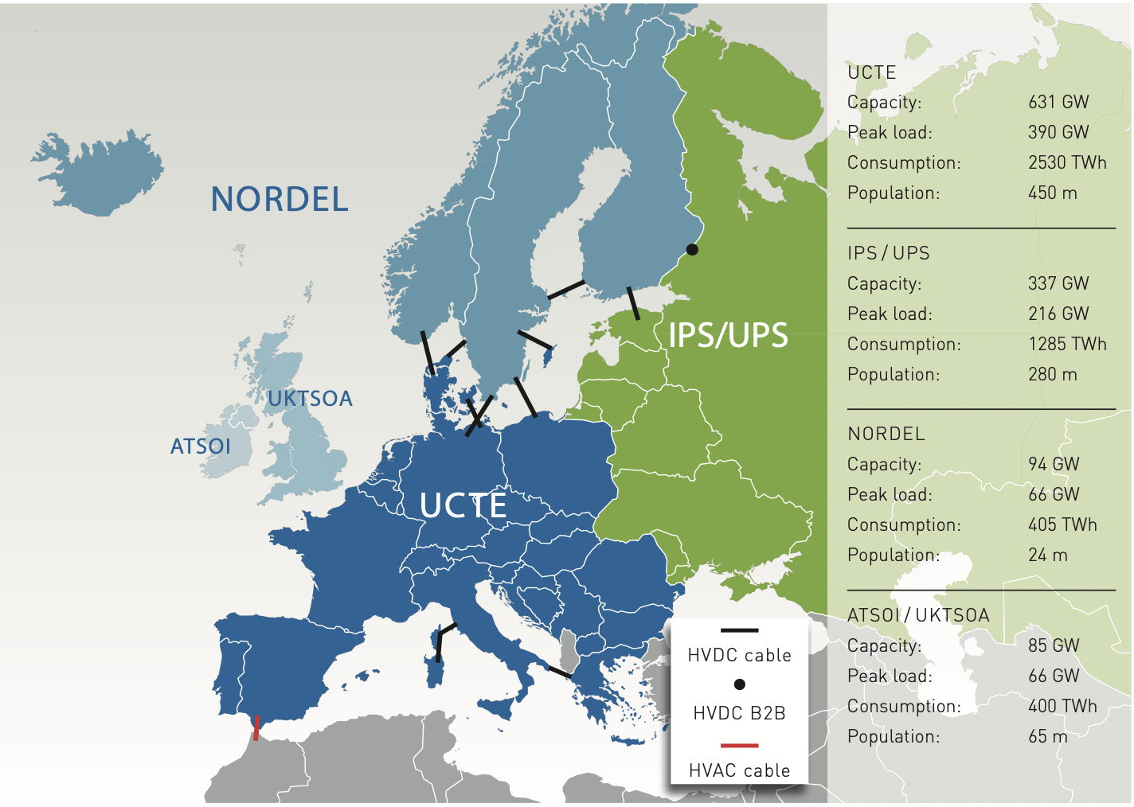
UCPTE => UCT
(Union for the Coordination of Production and Transmission of Electricity, until 1999)
Notes:
Over the last few decades, the UCPTE had adapted to changes in the European electricity sector, primarily
in response to the provisions of European Union Direc- tive 96 / 92 concerning common rules for the Internal
Electricity Market. The 1990s brought highly dynamic regulatory processes, as part of the move towards
a Single European Electricity Market, by means of the unbundling of generation, transmission and distribution services to ensure fair and non-discriminatory grid access for all users, and thus a more competitive
and viable market. For this reason the UCPTE changed its focus to the transmission grid only and, conse quently, changed its name to the UCTE, dropping the “P” for Production, in 1999.
IPS / UPS: Armenia, Azerbaijan, Belarus, Estonia, Georgia, Kazakhstan,
Kyrgyzstan, Latvia, Lithuania, Moldova, Tajikistan, Turkmenistan,
Ukraine, Uzbekistan
ATSOI / UKTSOA: Great Britain, Northern Ireland, Republic of Ireland
NORDEL: Denmark, Finland, Island, Norway, Sweden

Slide 18
Markets make possible advanced levels of multinational integration and many market-based cross-border power trade organisations presently exist worldwide

Slide 19
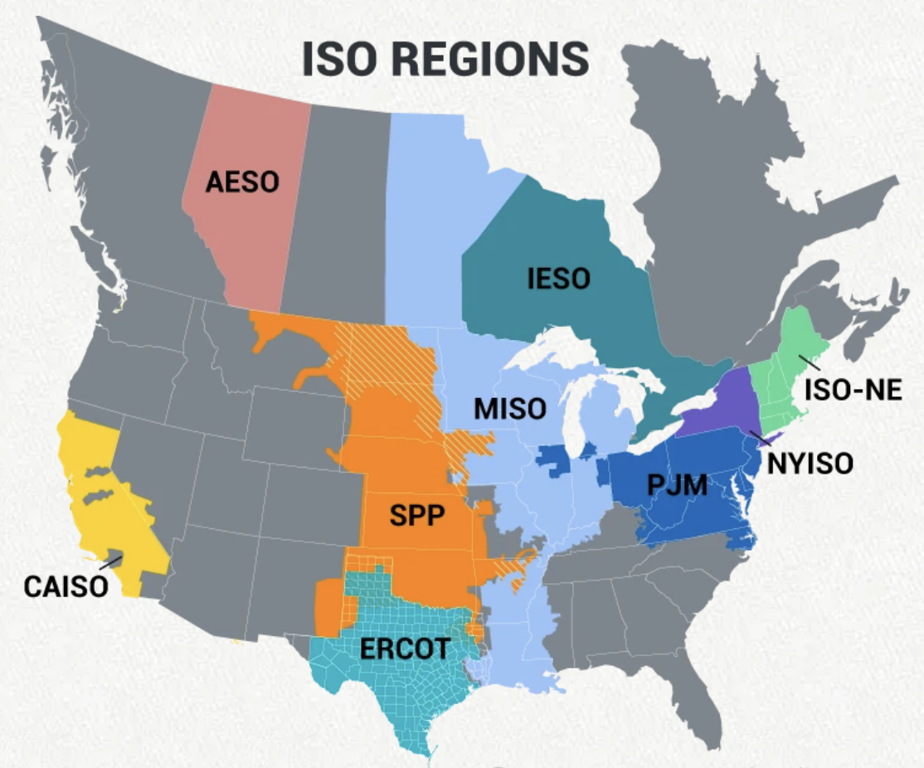
Present regional markets in the USA
Footprint of North American ISOs/RTOs
All ISOs/RTOs together:
336 US & 40 Canadian million people
2 countries
9,5 US & 10 Canadian million square km
Only PJM:
0.630 million square km
184 GW generation installed capacity
838 TWh/yr annual generation
Source: https://isorto.org

Slide 20
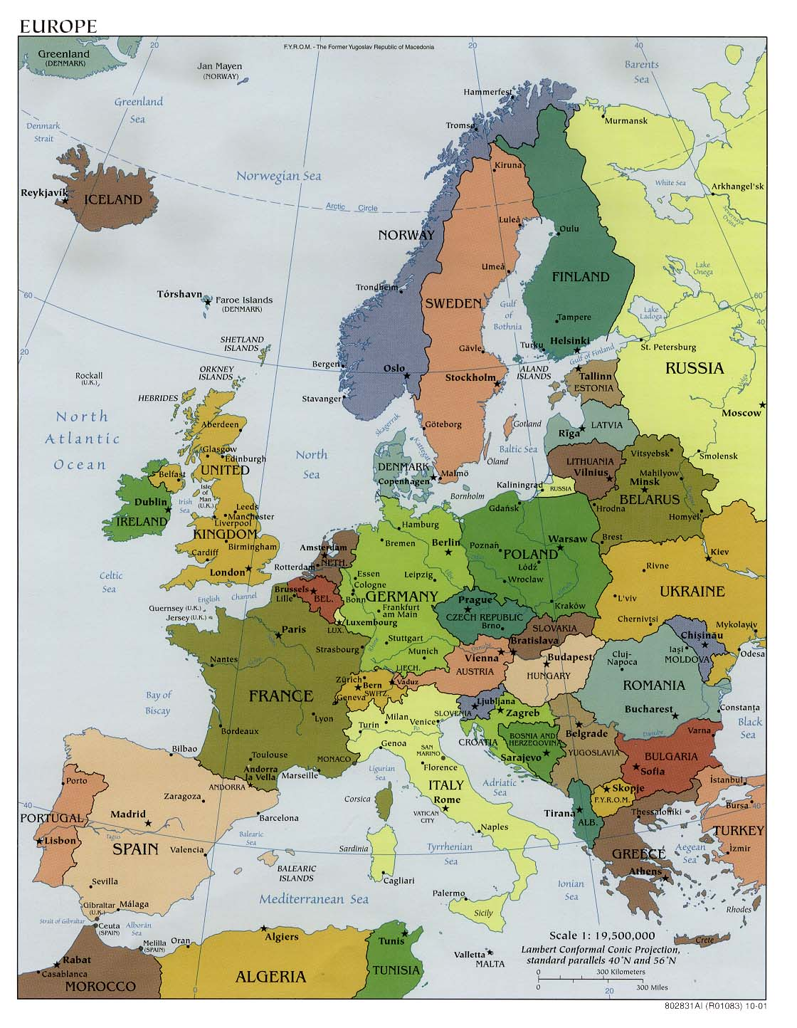
EU Internal Electricity Market
450 M people
27 countries
4,25 M square km
1000 GW installed generation capacity
2856 TWh annual generation
?
Notes:
European Single Day-Ahead Electricity Market Coupling. Important qualifications:
Norway participates in the integrated electricity market although it is not an EU member.
Great Britain is no longer part of EU Single Day-Ahead Coupling after Brexit, although it remains electrically interconnected and trades through separate arrangements.
Switzerland is physically central to the continental grid but is not fully incorporated into EU market coupling.
Cyprus and Malta are subject to EU electricity-market legislation, but their physical participation remains constrained by their isolation.
Several countries contain multiple bidding zones—especially Italy, Sweden, Denmark and Norway—whereas most countries have one.

Slide 21
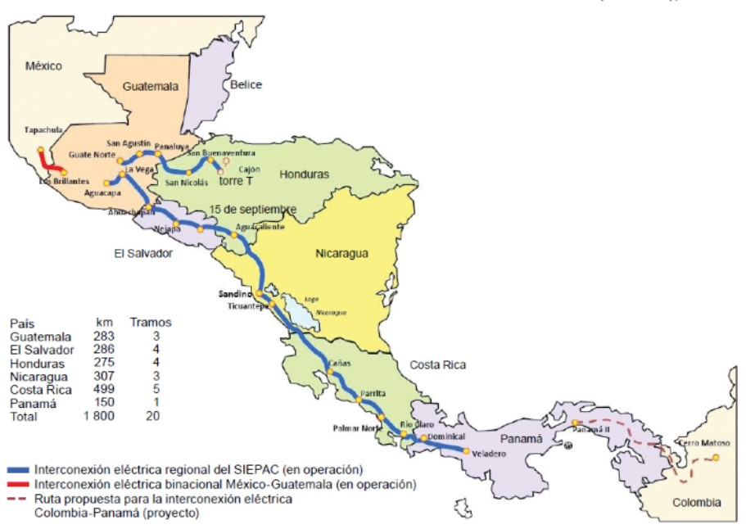
Central American Electricity Market
52 M people
6 countries
0,5 M square km

Slide 22
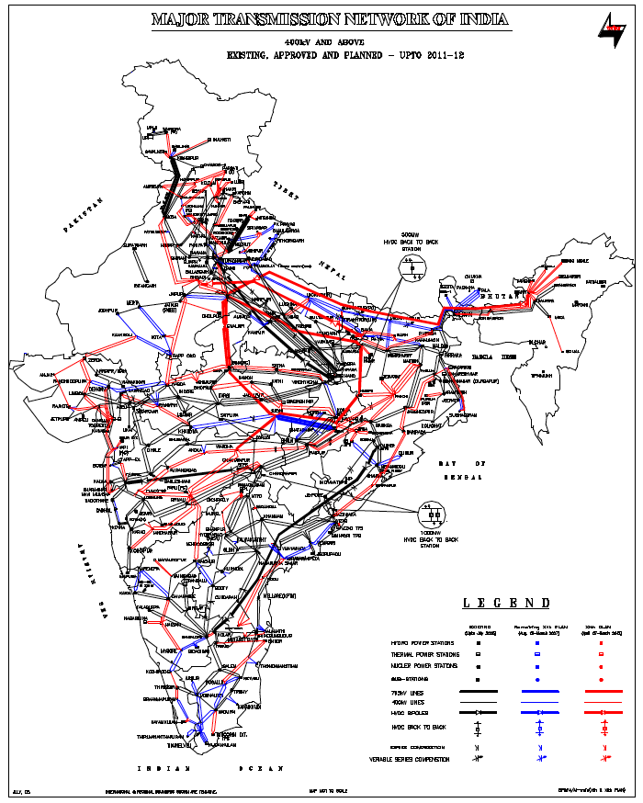
India Wholesale Market
1420 M people
1 country, 28 states
3,287 M square km
479 GW of installed generation capacity (excluding “captive”)
250 GW peak demand
Notes:
COMELEC 29.6 GW
WAPP 12.1 GW
CAPP 1.8 GW
EAPP 35.8 GW
SAPP 56.6 GW

Slide 23
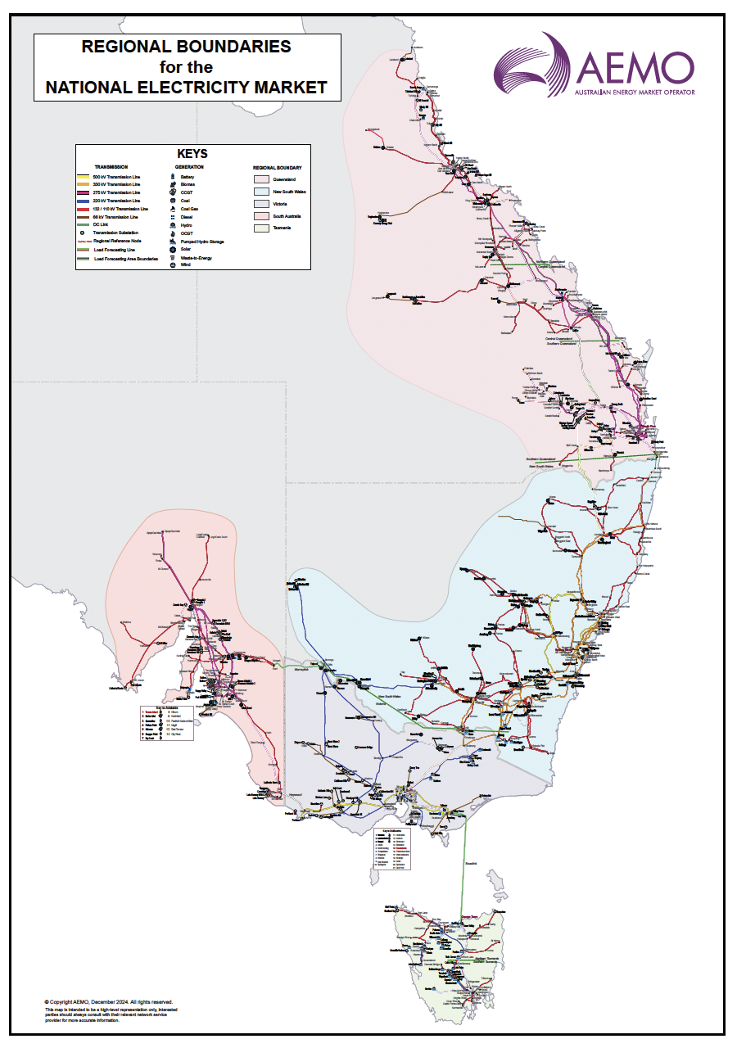
Australia National Electricity Market
22 M people
1 country, 5 states
5 M square km
65 GW of installed generation capacity
35 GW peak demand.
200 TWh annual generation (90% of total Australia)
Notes:
There are two wholesale markets in Australia: NEM (this one, supplying 90% of the demand) and WEM.

Slide 24
African Power Pools (in different levels of development) & their member states
Notes:
Note that here SAPP has less countries.

Slide 25
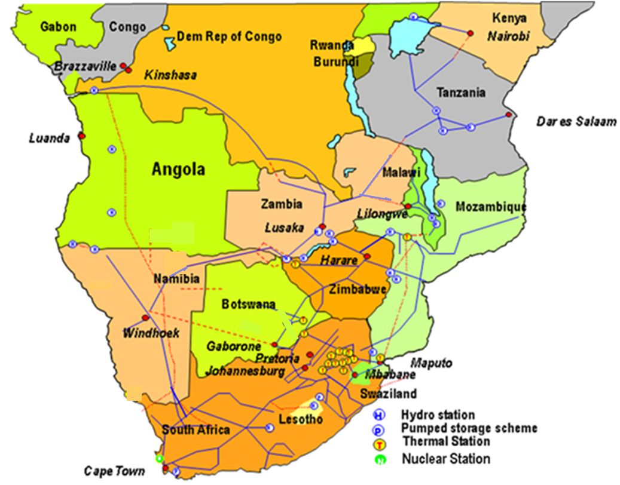
Southern Africa Power Pool
http://www.sapp.co.zw
380 M people
12 countries
9.1 M square km
58 GW of installed generation capacity
50 GW peak demand.
353 TWh annual generation.
Notes:
Explain why the SAPP is a compelling case study
SADC electricity sectors still largely take the form of vertically integrated public utilities
Problems with this model:
Not conducive to establishing a level playing field for new entrants
National utilities are responsible for all investment
Public resources must be shared with other sectors
poll for SAPP master plan found 75% of investments were supposed to come from private sector
Responding to the difficulty mobilizing financing for new projects, national reforms in all SAPP countries have been established or are underway to allow independent power producers to operate in these countries and the SAPP officially updated its protocols of agreement to permit IPPs and ITC to join as members, subject to approval by host governments
The success of the renewable energy auctions in South Africa show the large appetite among international companies to compete and operate in the region
Potential problem: this level of private sector investment has never been realized and IPP and project finance is a more complex process that requires more time and institutional capacity to get the project done
WB, USAID, Power Africa all now talking about building institutional project preparation capacity to take a project that passes a feasibility test and get it developed
How do they participate?
Single buyer model whereby all generators, public and private, must sell their power to the national utility and cannot compete directly in the regional market is still dominant in almost all member countries (mozambique and zambia are exceptions)
not good for IPPs or Demand response
In the current environment, investors need a long-term PPA in order to secure financing for a new generation project. This can be with a utility or a large consumer like a mine. The majority of trade in the sapp occurs through these long-term contracts, though this is starting to change. The volume of bilateral trades has gone down in the last few years.

Slide 26
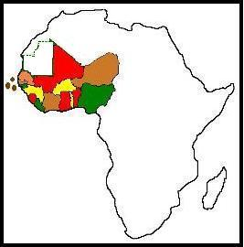
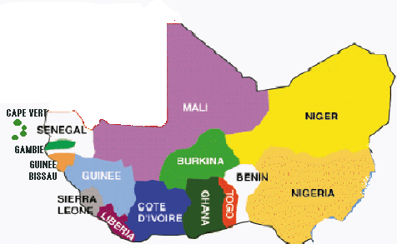
West Africa Power Pool
WAPP
244 M people served (57% of West Africa population)
15 countries
6.1 M square km
23.3 GW of installed generation capacity (2020)
11.5 GW peak demand (2020).
75.3 TWh annual generation (2020)

Slide 27












East Africa Power Pool EAPP
200MW
Existing Lines
Committed Lines
Future Lines
600 M people
13 countries
6 M square km
86 GW of installed generation capacity
60 GW peak demand.
293 TWh annual generation.
Load
80MW
200MW
180MW
200MW
300MW
1000 (Yr. 2030)
1000MW
HVDC2000 MW
100MW (Yr. 2030)
300 MW (Yr. 2027)
1000 (Yr. 2030)
152MW
363MW
140 MW
450 MW
500 MW (Yr. 2028)
450 MW
200MW
1500 MW (Yr. 2024)
TA-ZA -530MW (2027)

Slide 28
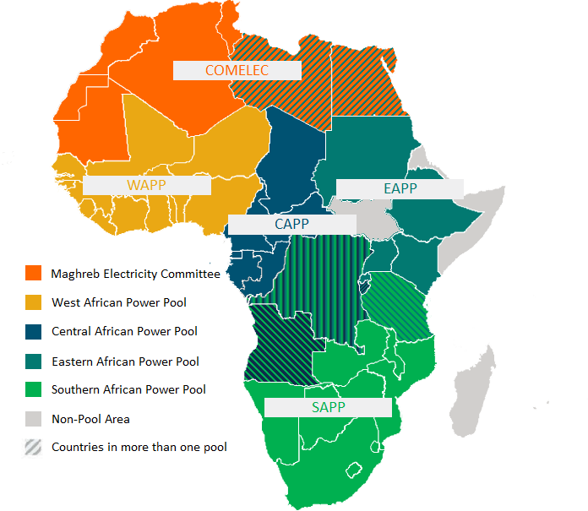
African Single Electricity Market, AfSEM
1540 M people
55 countries
30 M square km
5 power pools at diverse levels of development.
Regional Day-ahead markets with country prices in SAPP & WAPP.
Some regional SOs & regulators
African-wide indicative transmission planning (NEPAD)
?

Slide 29
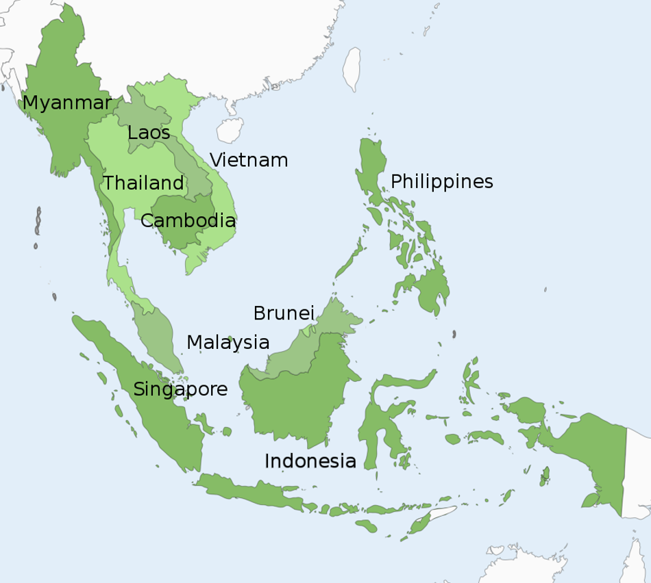
ASEAN Power Pool (still a project)
680 M people
10 countries
4.5 M square km
340 GW of installed generation capacity
220 GW GW peak demand.
1500 TWh annual generation.
?

Slide 30
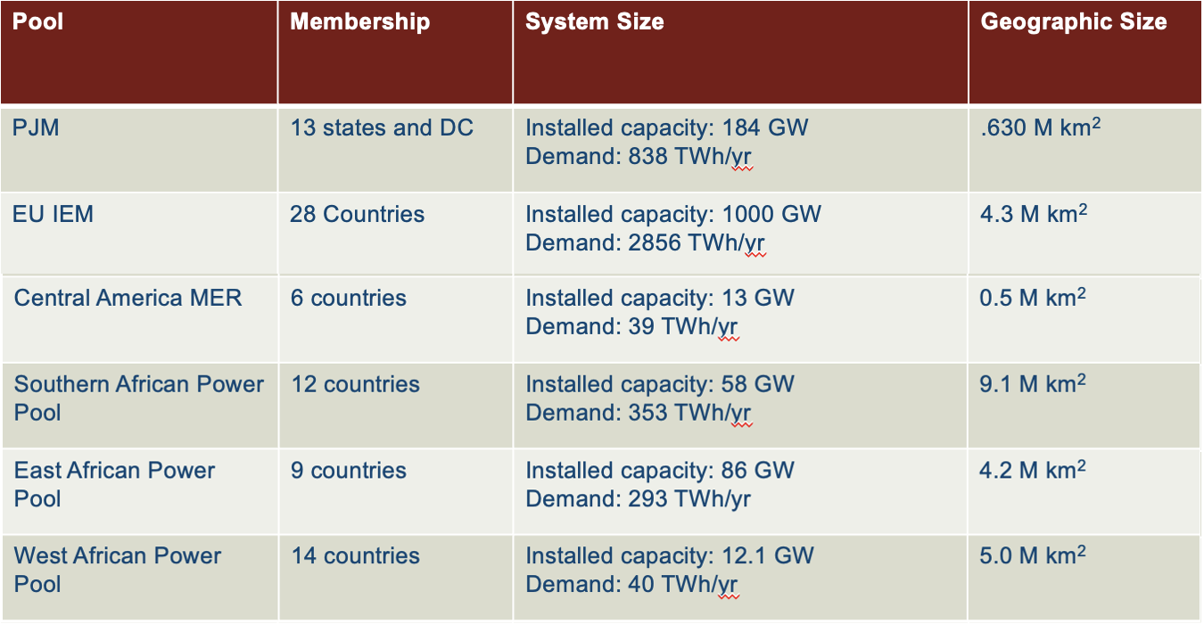
Some electrical size perspective
ASEAN
10 countries
Installed capacity 315 GW (2022)
Demand: 1390 TWh
4.5 M km²
Notes:
Population:
PJM: 67 M
ASEAN: 678 M
EU: 450 M
WAPP: 450 M
EAPP: 631 M
SAPP: 377 M
MER: 52 M

Slide 31
Outline
The benefits of cross-border trade / regional markets
Does integration need markets?
Markets facilitate advanced multinational integration
Issues to be addressed in the design and implementation of regional electricity markets
  mmm
Market design
Governance
Capacity expansion
Transmission network utilization and system operation

Slide 32
Let’s liberalise multinational trade…
What issues must be addressed?
Notes:
Xxx introduce a simple hand drawn regional system xxx

Slide 33
Market design for cross-border trade
What products / commodities can be traded in addition to energy?
Are there established platforms / formats (contracts, settlement) to facilitate trade? Short-term? Longer-term?
What agents in a country can be eligible to trade abroad? Should they? Must they be subject to some limitations?
How to develop reliable prices for the traded commodities that can serve as a reference to establish contracts and to compute settlements? Must these prices be unique throughout the region?
How to prevent and detect the exercise of market power?

Slide 34
Governance
Who is in charge? Who sets the rules? How are the rules designed, implemented and enforced? Is there a supranational authority? Are there responsibilities delegated to lower-level authorities?
How to capture what countries want, in the design of the multinational power trade market? Let all eligible agents trade freely? Or centralised national dispatch, including imports and exports?
Can security of supply be trusted to other countries? How can agents guarantee their supply within their countries or abroad? What kind of long-term contracts can be signed?

Slide 35
Capacity expansion
Who plans to build transmission of regional relevance? What are the criteria to select new investments? How is the plan enforced?
Is private investment in cross-border transmission acceptable? What business models are adequate to attract private investment?
Should a generation expansion plan exist? How to use it? Should capacity payment mechanisms be implemented, and, if this is the case, should they be harmonised?

Slide 36
Transmission network utilisation and system operation
How the cost of cross-border transmission infrastructure must be allocated to the countries or the agents? How much to pay for network use?
Must transited countries that do not trade much be compensated?
What happens if the proposed cross-border trade exceeds the existing network capacity?
How is operation security – frequency and voltage control, operation reserves, stability and emergency control – guaranteed at regional level?
Is a regional system operator needed?

Slide 37
Outline
The benefits of cross-border trade / regional markets
Does integration need markets?
Markets facilitate advanced multinational integration
Issues to be addressed in the design and implementation of regional electricity markets
  mmm
Market design
Governance
Capacity expansion
Transmission network utilization and system operation

Slide 38
The design of regional markets must be guided by the adoption and adaptation, as needed, of working best practices in advanced regional power trading organisations.

Slide 39
Regulation for regional (or continental) trade must be guided by the “Single system paradigm”
The “Single system paradigm”
Design regional (or continental) regulation so that the expected outcome is as close as possible to that of a sound regulation for a single system of regional dimension.
And establish regional (or continental) institutions with regional (or continental) jurisdiction & executive power.

Slide 40
Therefore, abandon this mindset…
?

Slide 41
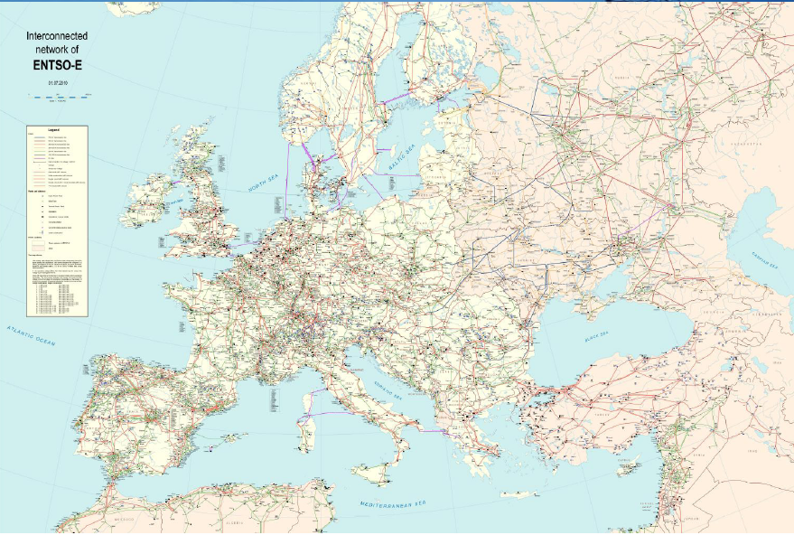
… and design the market with this perspective…

Slide 42
… abandon this vision…

Slide 43
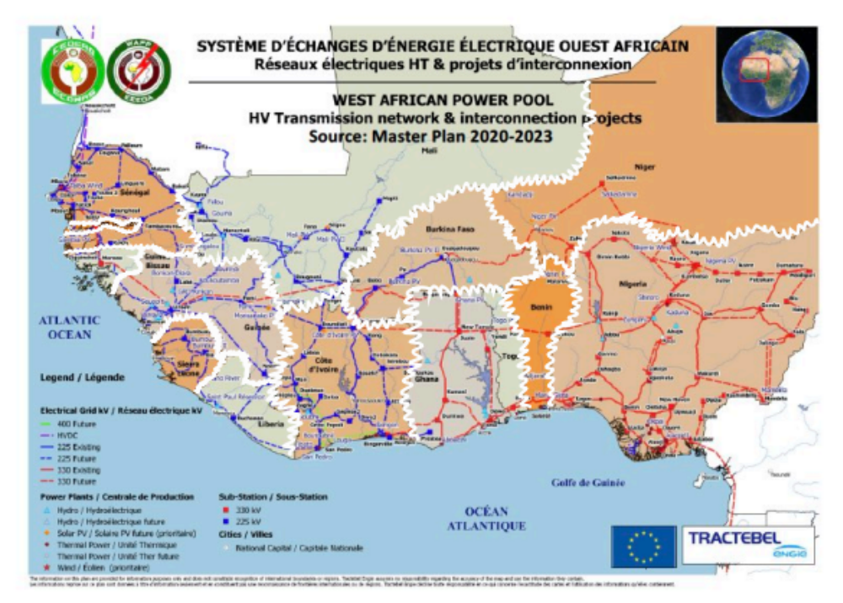
… and adopt this one
(partly adopted in WAPP)

Slide 44
What are the implications of adopting the Single System Paradigm?
For instance…
Each market agent, producer or consumer, must pay a single network charge, which should approximate the charge that would be applied in a single country encompassing the entire considered region (or continent).
At any given time, the total demand in the region (or continent) must be met by the lowest cost combination of generation plants, while taking network capacity & losses into consideration.

Slide 45
The objective is an efficient region-wide economic operation
Efficient utilization of transmission capacity

Slide 46
Basic principles for the efficient utilisation of transmission capacity
The starting point is a short-term centralized economic operation (including the network) over the entire region.
The network model considered should accurately reflect the flows on the congested transmission lines.
  If it is decided to use single-price areas (SPAs) instead of physical nodes, the relevant congestion patterns should be considered when dividing the system into SPAs.
The risk associated with the variability of differences of short-term energy prices between nodes or SPAs must be managed with financial, point-to-point, hedging contracts.

Slide 47
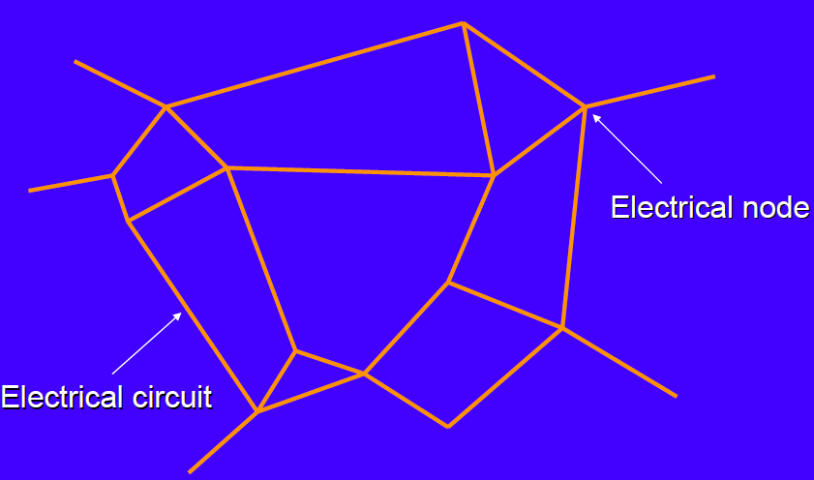
Standard physical network representation

Slide 48
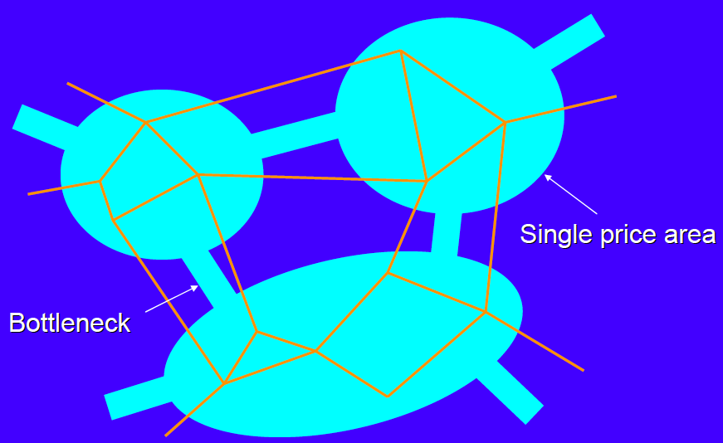
Simplified network model using SPAs

Slide 49
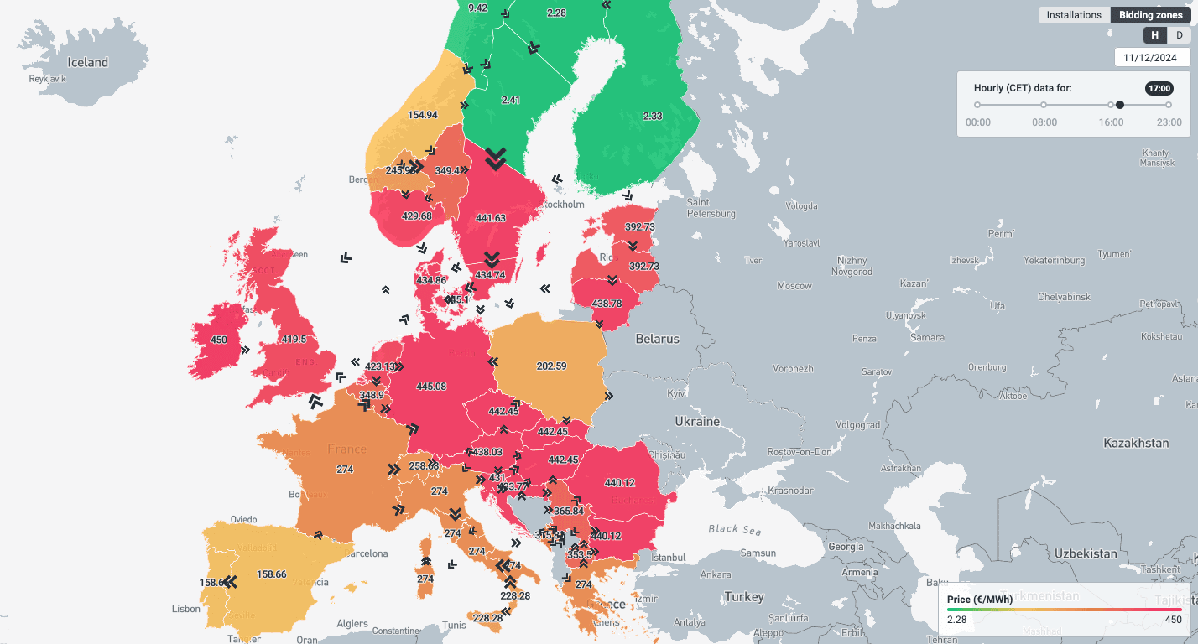
Day-ahead electricity prices across European bidding zones
11 December 2024, 17:00 CET — €/MWh

Slide 50
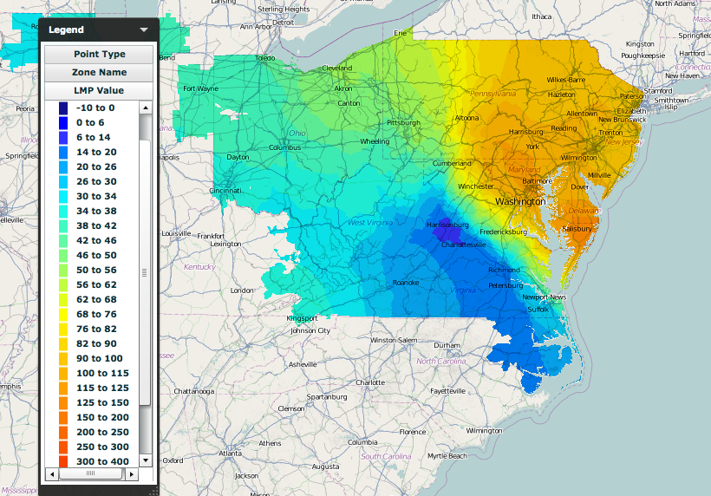
Sample of nodal prices at PJM
/Users/ipa/Library/Containers/com.apple.Preview/Data/Desktop/Screen Shot 2012-10-11 at 12.58.01 AM.png

Slide 51
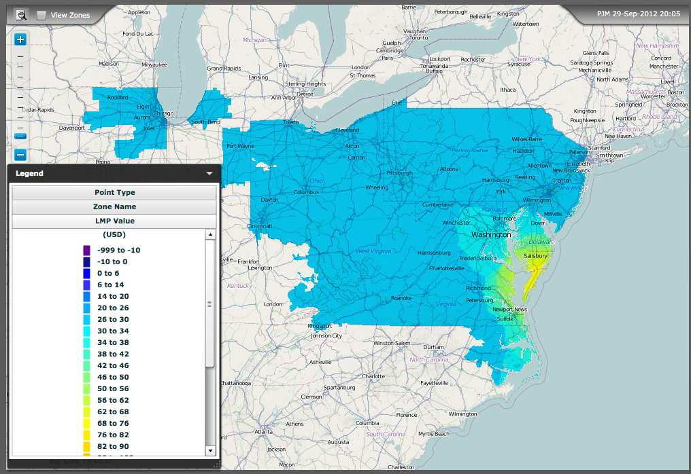
Sample of nodal prices at PJM

Slide 52
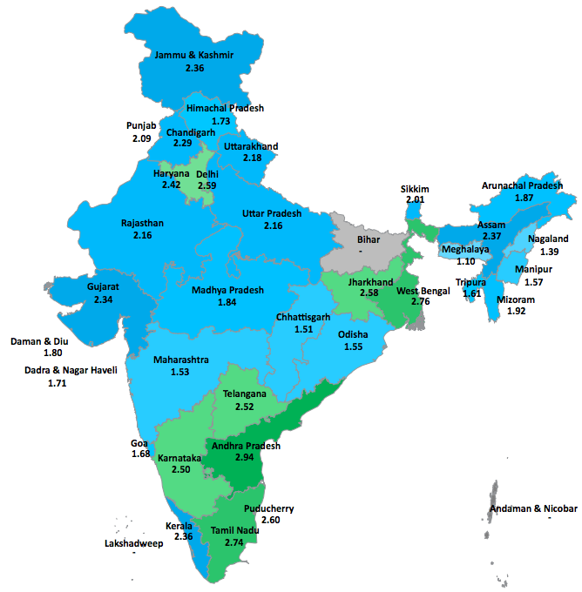
ZONAL prices in the Indian states

Slide 53
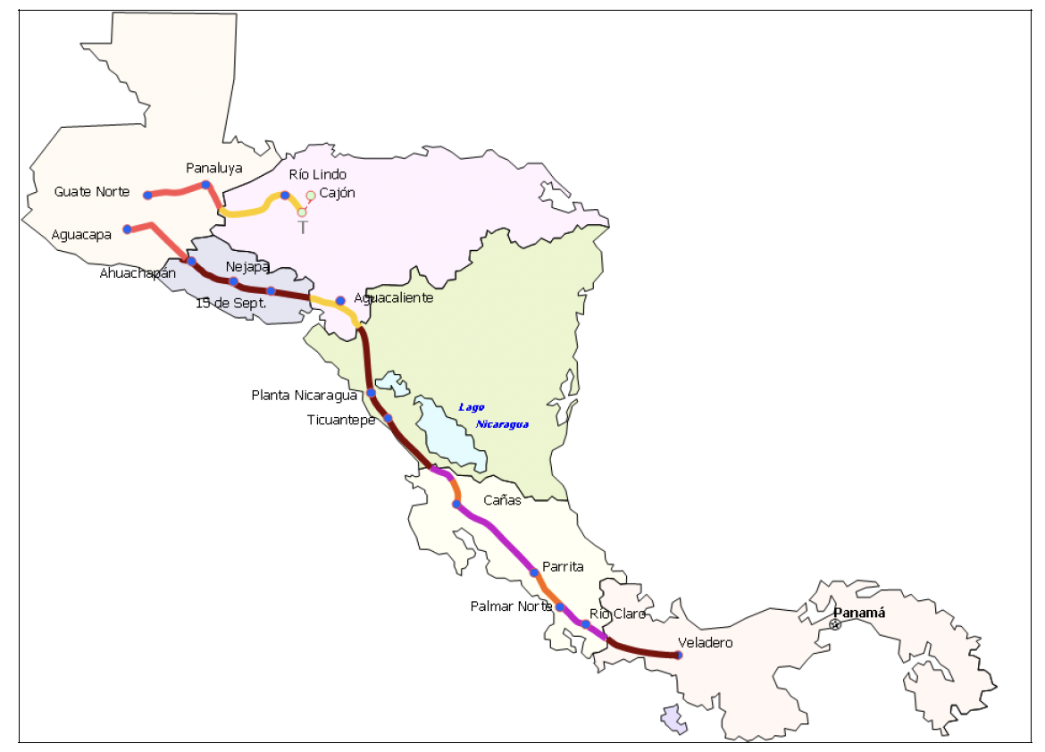
The Central American Regional Market (MER)
An individual day ahead market per country, followed by a regional-wide market that integrates the bids of demand and supply from each country at the regional network nodes.
The centralised regional economic operation yields nodal energy prices at the nodes of the regional network.

Slide 54
The objective is an efficient region-wide economic operation
Avoid the inefficient utilization of bilateral contracts

Slide 55
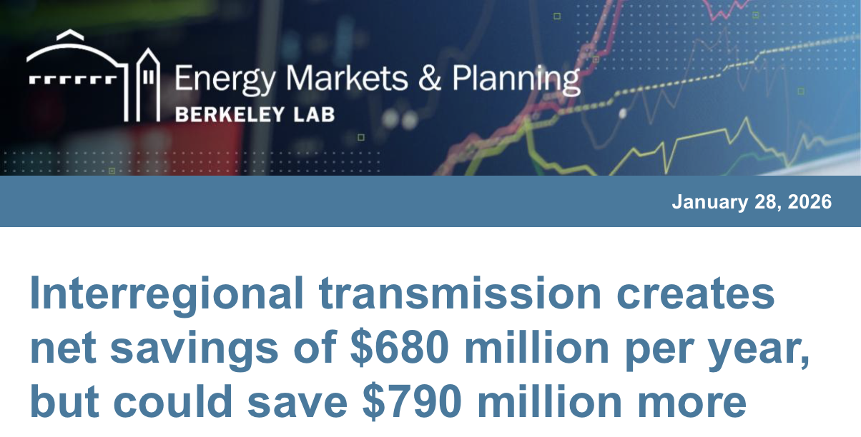
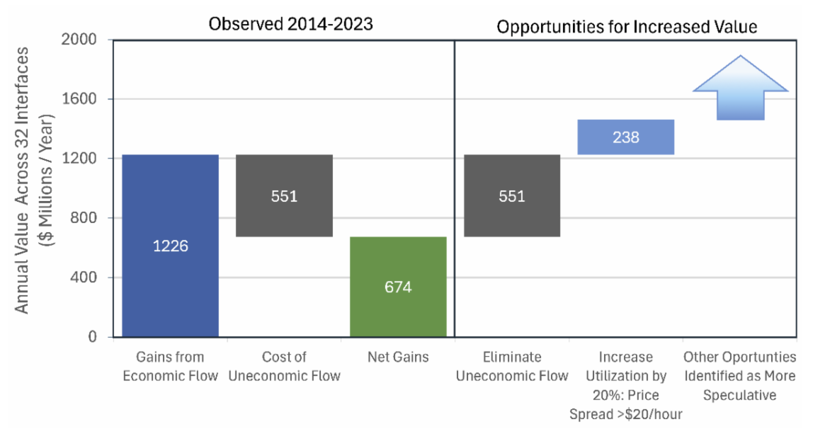
Electricity trade between regions can help lower costs by tapping least cost generation sources and increasing use of the existing grid, spreading costs over more kilowatt-hours. It can also boost reliability during extreme weather events and help deliver more power where it is needed, a critical issue as new data centres drive up demand.
But these benefits can be eroded by market flaws, barriers, and inefficiencies, reducing total benefits by hundreds of millions of dollars.
The study finds that transfers saved $1.2 billion per year by moving energy from lower to higher-priced regions. But almost half of the value of these gains was lost due to uneconomic transactions in other hours, resulting in a net savings of $680 million per year. Much of this value, and more – up to $790 million – could be regained by solving these problems.
One important aspect of the study is that it focuses on electric sector cost savings that could derive from operational changes to the current infrastructure, by changing software and policies rather than hardware. These savings could be achieved while avoiding the challenges of building new transmission lines.
https://journals.sagepub.com/doi/10.1177/01956574251399644

Slide 56
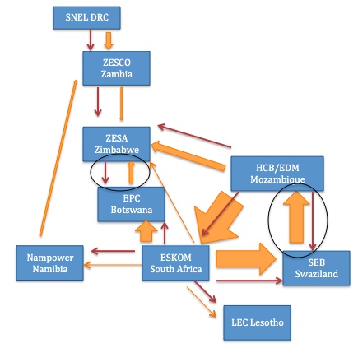
Comparison of optimal trade flows with direction of bilateral contracts in the SAPP
Amy Rose. PhD thesis. MIT – IDSS - 2017

Slide 57
The efficient use of bilateral contracts
Bilateral contracts seek to hedge against price uncertainty & to increase security of supply.
However, physical bilateral contracts imply physical obligations (i.e., they are dispatched even if a lower cost alternative exists).
  This introduces inefficiencies unnecessarily in the use of generation and transmission infrastructure, reduces total trade and increases system costs.
The alternative are purely financial contracts (therefore, ignored in the dispatch of generation under normal supply conditions) which only turn to physical (providing supply guarantee) under scarcity conditions.
  This is an important first step towards security of supply at regional level.
(*) Source: Amy Rose, “Improving the performance of regional electricity markets in developing countries: The case of the Southern African Power Pool”. PhD thesis, MIT IDSS, May 2017.

Slide 58
Implicit Auctions with Security of Supply Guarantees
They incorporate the desirable features of physical and financial contracts.
  When there is no scarcity, contracts do not interfere with efficient market outcomes.
  During scarcity, contracts offer consumers and investors the same level of risk reduction provided by firm bilateral contracts.
They are compatible with the usual rules of operation of regional power trade organisations
  Parties can continue signing long-term contracts for any capacity at privately negotiated prices, subject to transmission availability.
  Economic operation is centralized.

Slide 59
The objective is an efficient region-wide economic operation
Trying to achieve a regional vision of security of supply

Slide 60
Trust and a regional vision of security of supply
Generation plants of “regional size” are necessary to exploit economies of scale for countries of small electrical size, also given the uneven location of the best energy resources & the variability of wind, solar & hydro. Thus
  Some countries must trust their security of supply to power plants located abroad
  Some countries must build large power plants trusting that off-takers in other countries will honor their contracts, and commit to export power even under situations of national scarcity
This level of trust, in particular relying on external energy sources to meet the national demand, appears impossible to obtain, thus jeopardizing a truly regional vision of security of electricity supply.

Slide 61
The objective is an efficient region-wide economic operation
The challenge of market power mitigation

Slide 62
Prerequisites to establish wholesale electricity markets
Markets can only be successfully established after making sure that the considered power system meets some conditions and after making sure that the countries are willing to make the necessary changes to satisfy these conditions. What are they?
  An adequate structure of the market agents – mostly the producers, but also the off-takers – with several competing companies, so that none of them can modify the market price obtaining a significant benefit from this decision.
  A relevant market of sufficient dimension, so that various companies can meet the entire demand without significant bottlenecks or local dominant positions.
  Correct market rules that allow fair competition in the efficient utilisation of resources, price determination, allocation of network and any other charges, and avoidance of market power abuse.

Slide 63
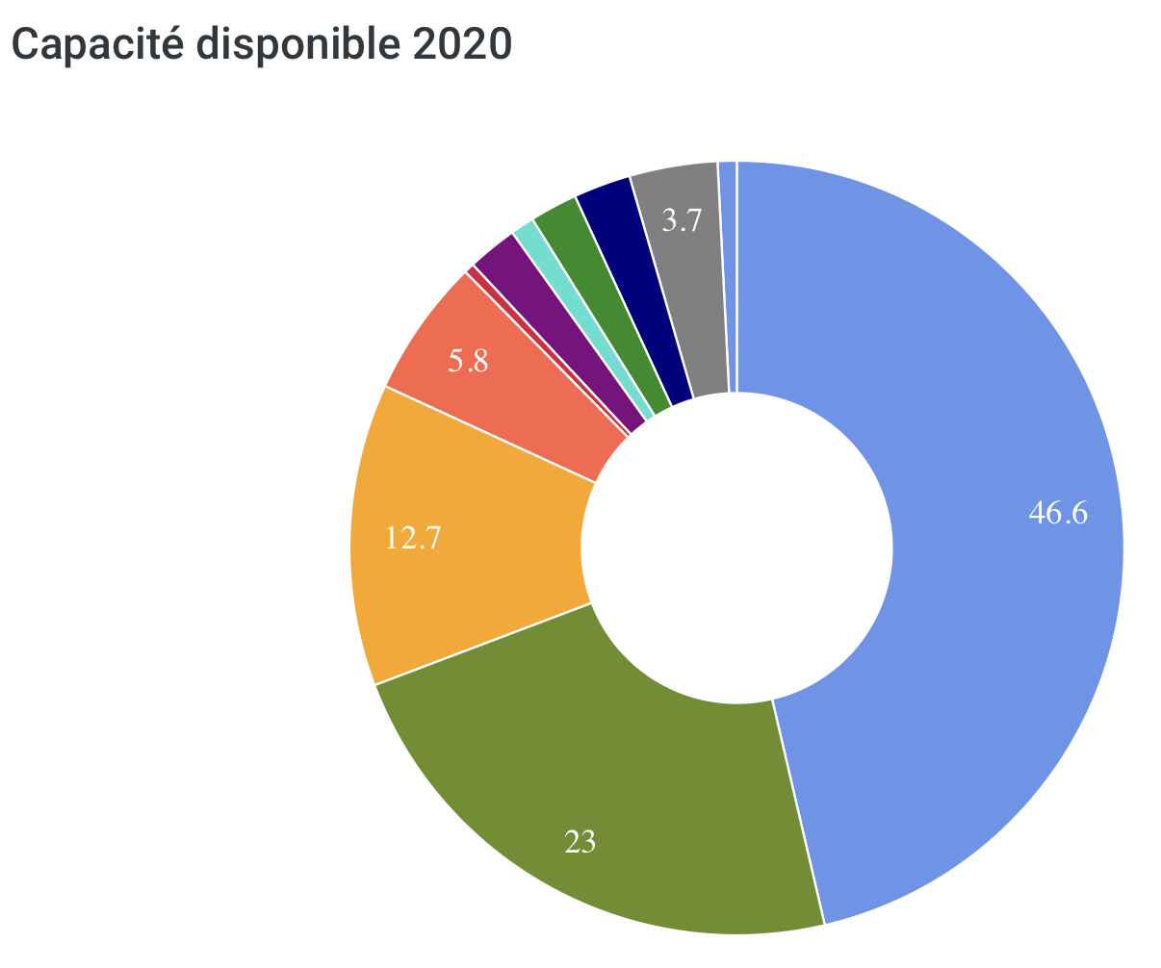
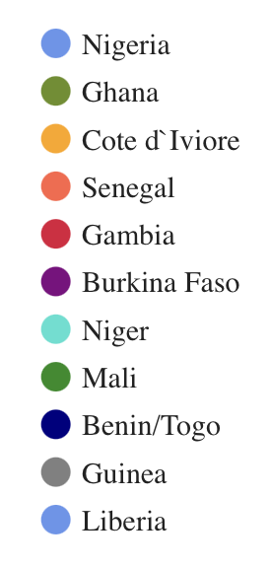
A strong interconnection expands the size of the market and helps to mitigate market power; however, …
Example (WAPP)
The level of horizontal market concentration suggests that measures must be adopted to limit market power, both at national and even regional level

Slide 64
Outline
The benefits of cross-border trade / regional markets
Does integration need markets?
Markets facilitate advanced multinational integration
Issues to be addressed in the design and implementation of regional electricity markets
  mmm
Market design
Governance
Capacity expansion
Transmission network utilization and system operation

Slide 65
The essential components of “cross-border” power trade
Coordinated “cross-border” system operation.
  Network congestions, security, frequency control, power restoration.
Coordination rules to efficiently share and plan the capacity expansion of common infrastructure.
  Schedule bilateral trade, scheduling economic trade, allocation of transmission costs, joint planning of infrastructure capacity expansion.
Ultimate responsibility for joint decision making.
  Agreement protocol (multi-utility, multinational), supra national government.

Slide 66
The institutions for regional power trade
Regional body, treaty
Supranational authority
Regional regulations
Regional Regulator
Regional planning
Coordinated regional system operation and economic dispatch
Regional System Operator

Slide 67




Regional cooperation among national regulators
Voluntary
Voluntary association of national/State regulators:
  to share practices and identify best practices
  to promote collaboration on an ad-hoc basis
Statutory
Statutory cooperation entity:
  tasked with ensuring cooperation and joint decision making by national regulators in specified areas:
  possibly stepping in when national regulators disagree
Regional entity
Separate entity with regional/federal decision-making powers

Slide 68
The governance of the Regional Electricity Market
Case example: Central American Regional Electricity Market, MER
Steering Committee (CDMER)
Political organ of the MER
Promotes the evolution and development of the MER
Formulates the conditions conducive to generation capacity expansion
Ensures that changes in national regulations are gradually carried out in order to harmonise them with regional regulations
Regional Commission for Electricity Interconnection (CRIE)
Regulatory body
Regulates the physical and economic dispatch
Regulates aspects concerning regional transmission and generation
Approves the tariffs for the use of the regional transmission system
Imposes sanction for non-compliance with the Treaty and Regulations
Regional Operating Entity (EOR)
System and Market Operating Entity
Ensures that the operation and regional dispatch of energy is carried out with economic criteria and adequate levels of safety, quality and reliability
Carries out the settlement of transactions between market agents
Formulate the indicative transmission and generation expansion plans
68
68

Slide 69




Institutional Structure of the Regional Electricity Market in Central America
Regional Electricity Market Board of Directors
6 Energy Ministries or Councils
Regional Regulatory Commission for Electricity Interconnection
Regional Operating Entity
6 National Regulators
6 System and Market Operators
Regional Transmission Company owns the critical corridor
Privately owned and governed
(no shareholder can own more than 15% of the EPR)
69
Notes:
Xxx The Empresa Propietaria de la Red (EPR) is a consortium (Special Purpose Vehicle, SPV) of private and public companies (the six publicly owned utilities of the six Central American countries plus three extra-regional shareholders (Mexico’s CFE, Endesa/Enel from Spain and ISA from Colombia).

Slide 70
Cross-border cooperation among TSOs – various levels
Operational cooperation
Ensure the safe and coordinated operation of the interconnector/ synchronous systems
Experience sharing
Share experience and expertise
Identify best practices
Mutual assistance
Mutual assistance in the case of emergency situations
Developing common rules and standards
Developing common rules and standards for system and market integration (beyond those for safe and coordinated system operation)
Regional System Operator
Delegating system operation functions of regional scope to a regional entity. It typically includes transmission planning and may include market operation.
Notes:
TASKS:
operational security of the interconnector
the methodology for calculating the available interconnection capacity
the possible allocation of the capacity of the interconnector (coordination promotes a greater use of the capacity)
the scheduling and accounting of power flows on the interconnector
the scheduling of maintenance of the interconnector
the procedures for handling emergencies/unplanned outages of the interconnector
communication and data exchange.
technical standards for the synchronous operation of the system (e.g. frequency control and system performance)
the procedures for the activation of reserves
the procedure for compensating deviations of actual flows from schedule
the procedures for black-start and for re-synchronisation across the interconnector, following an accident causing the separation of the different control areas.

Slide 71
The process of development of a regional market
Most regional power markets have developed gradually, in terms of both:
  the sophistication of the trading arrangements.
  the geographical scope.
Most of the benefits could already be reaped at the early stage of the integration process.
Significant benefits could be achieved by always ensuring the efficient use of the cross-border interconnection capacity.

Slide 72
Regulation by consensus… of the regulatory authorities
An example of what is possible…
In 1996 the EUC passed the Internal Electricity Market Directive, but cross-border trade did not happen. Starting in 1998, the regulatory authorities convened in Florence (Italy), agreed on the trade rules, & mandated their respective system operators to implement them.
Later, the EUC passed the regulation that made these rules official for EU countries.
Regulators continue meeting every 6 months to monitor the process.

Slide 73
Outline
The benefits of cross-border trade / regional markets
Does integration need markets?
Markets facilitate advanced multinational integration
Issues to be addressed in the design and implementation of regional electricity markets
  mmm
Market design
Governance
Capacity expansion
Transmission network utilization and system operation

Slide 74
Transmission planning with a regional perspective
The regional transmission grid should be determined centrally with a top-down approach combined with a bottom up one.
  Taking also into account the knowledge of the regional or national networks and specifics of the grid and the needed investments.
All the benefits of potential cross-border transmission investments should be considered jointly together with their costs.
  Across countries throughout the region.
  Including benefits of all types.
All the regional transmission investments should be planned jointly.
  Investment projects are interdependent regarding the benefits they produce.

Slide 75
The “regulatory test”
What is a “justified” investment?
The golden rule of transmission investment:
“Invest in projects with an estimated ratio of system benefits over transmission costs over the useful life of the asset clearly larger than 1.0”
Transmission costs can be estimated accurately.
However, future system benefits are difficult to estimate: i) because of uncertainty in future system behaviour; and ii) because of the diverse nature of the potential benefits to be considered.

Slide 76
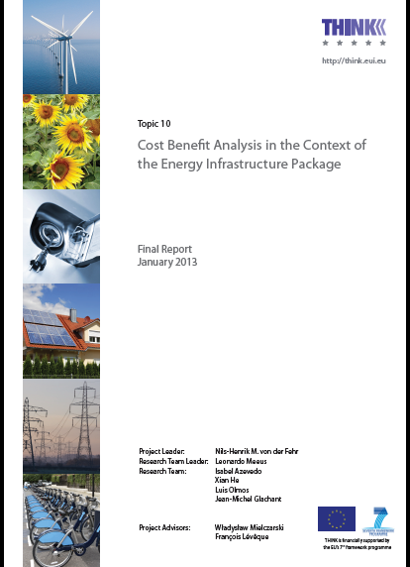
Cost / benefit analysis of transmission investments
Planning criteria should account for several categories of benefits:
Reliability improvement
System operation cost reduction
Market building at national and regional levels
Market power mitigation
Implementation of energy policies (environmental targets, cover the entire national territory)
Notes:
The economic effects of developing electricity transmission or storage projects include:
the impact on the power system, as well as the effects beyond the system, i.e., externalities and macroeconomic effects.
The impact on the power system can be categorized into production versus consumption effects, infrastructure costs and other market benefits, such as improved competition and liquidity.
The externalities are related to the impact of these projects on greenhouse gas emissions, renewable energy, local environmental and social costs, and the early deployment of innovative transmission or storage technologies.

Slide 77
Who decides the investments in transmission at regional level?
The experience of the EU Internal Electricity Market

Slide 78
EU-wide transmission planning
Non mandatory EU-wide 10-year ahead transmission expansion plan prepared by ENTSO-E every other year (European Network of Transmission System Operators for Electricity)
  First draft plan published 1 March 2010
Mandatory national transmission expansion plans (prepared by national TSOs & approved & enforced by national regulators)
Final decisions are left to national regulators & TSOs with ACER supervising compliance with EU-wide plan

Slide 79
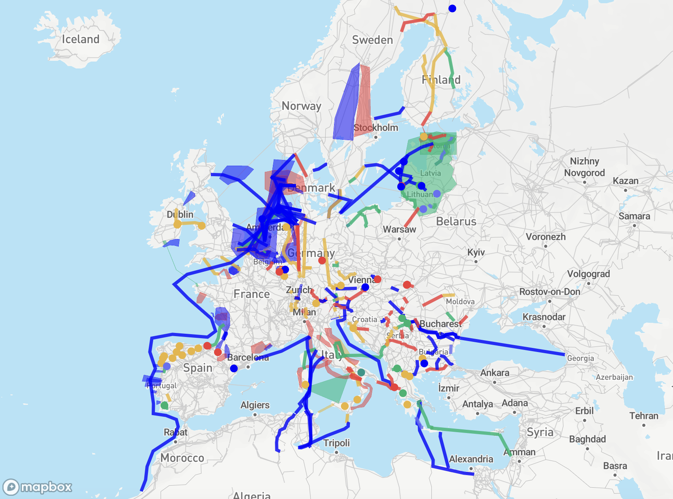
The EU association of System Operators ENTSO-E Ten-Year Network Development Plan (TYNDP) is developed every other year.
TYNDP 2024 includes 176 transmission projects and 33 storage projects.
These projects receive priority administrative treatment and subsidies of different kinds.
https://tyndp.entsoe.eu/explore#explore__longterm

Slide 80
Interconnectors

Slide 81
Interconnectors
Cross-border transmission projects are indispensable for cross-border trade.
They must be jointly undertaken by host governments and/or utilities, what presents specific implementation challenges:
  Joint development and joint ownership models.
  Funding constraints.
  Diverse domestic regulatory frameworks.
Private sector participation is sometimes a viable option for reducing or mitigating such risks.

Slide 82
Joint development and joint ownership models
Usually, an Inter Governmental Memorandum of Understanding is the starting point of the project.
Interconnection projects can be constructed, developed and owned individually by each involved country, typically for those portions within the territory of the respective country.
Interconnection projects can also be undertaken jointly by all the countries, which will launch an auction to select a private investor to develop, and maintain the infrastructure..
  A procedure must be established to allocate the project costs to each country.

Slide 83
Outline
The benefits of cross-border trade / regional markets
Does integration need markets?
Markets facilitate advanced multinational integration
Issues to be addressed in the design and implementation of regional electricity markets
  mmm
Market design
Governance
Capacity expansion
Transmission network utilization and system operation

Slide 84
Cost allocation of regional transmission projects
The principles
The transmission network charge applied to a network user in its country must give access to the entire regional market
  This is a consequence of the “single system paradigm”
Transmission charges must not depend on commercial transactions, but on the benefit obtained from (or “use of”) the network, or some proxy, if benefits are difficult to evaluate.
  Ignoring this principle, levies too high charges on cross-border trade, killing it
The sounder the regulation the lower the risk of opposition to a transmission project.

Slide 85
Transmission network charges must not depend on commercial transactions
Therefore…
A generator in Togo and an industry in Senegal engaged in a bilateral electricity contract, must pay a single transmission charge in their respective countries, according to the “Single System paradigm”.
These charges are the same as if the generator in Togo were selling to an industrial customer in Togo or if the industry in Senegal were purchasing electricity from a generator in Senegal.

Slide 86
Cost allocation of regional transmission projects
A pragmatic approach based on “best practice”
Avoid “pancaking” & charges associated to commercial transactions.
Agreement among countries for a stable allocation to countries of the cost of major projects.
  Try allocation to countries based on estimated benefits, otherwise…
  … track sources and sinks of actual or forecasted flows, minimizing the use of extra assumptions.
Tracking sources & sinks allows determining inter-country compensations.
  After that, each country will allocate internally the modified transmission total cost following its own principles.
Notes:
Resort to allocation to beneficiaries or responsibility in network investments in special / relevant cases of new transmission projects.

Slide 87
Cost allocation of regional transmission projects
A pragmatic approach based on “best practice”
In major projects it might be possible to negotiate the percentage to be allocated to each country
Otherwise, & for minor projects & the existing grid, use some tracking-flows method applied to actual past or future estimated flow patterns to assign the use (& cost) of each asset to individual generation plants & loads…
  … & then to countries, by aggregation.
    This results in the desired percentages for large projects & in inter-country compensations for the rest of the network.
  The average participations method can be trusted for this job.

Slide 88
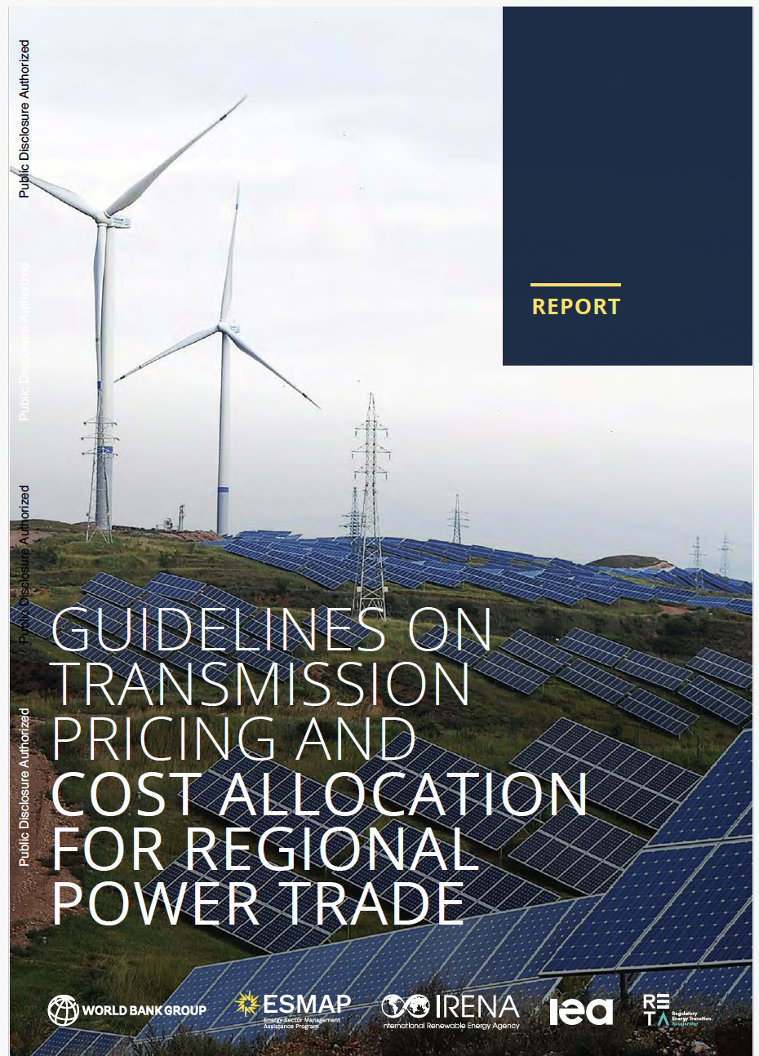
https://www.esmap.org/publications/guidelines-transmission-pricing-and-cost-allocation-regional-power-trade

Slide 89
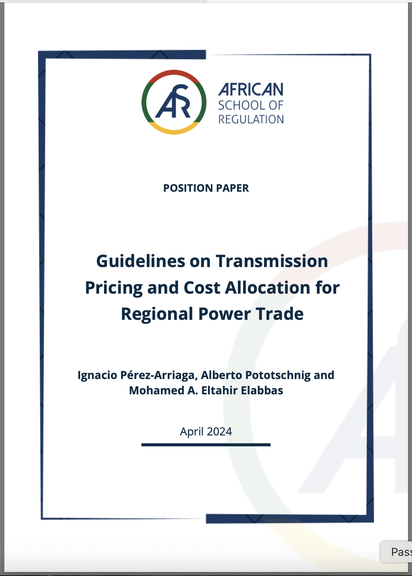
https://africanschoolregulation.org/wp-content/uploads/2025/07/Guidelines-on-Transmission-Pricing-and-Cost-Allocation-for-Regional-Power-Trade.pdf

Slide 90
Network congestion management in regional power trade

Slide 91
Congestion
Congestion occurs when the available transmission capacity is not sufficient to satisfy the demand for transmission services (e.g., from commercial transactions)
Therefore, congestion depends:
  on the demand for transmission services
  on the available transmission capacity
Liberalisation has increased and made the demand for transmission services more explicit

Slide 92
Approaches to congestion management
Ex-post congestion management
  Re-dispatching
  Counter-trading
Ex-ante congestion management
  Explicit allocation of (physical) transmission capacity rights (PTRs).
  Implicit allocation of transmission rights (and energy positions)
    Market Splitting
    Market Coupling (possibly with an explicit allocation of (long-term) Financial Transmission Rights (FTRs))

Slide 93
Network capacity contracts
These are long-term risk hedging contracts that try to reduce or to eliminate economic risks that network congestions may cause in bilateral transactions.
  Large volatility in the difference in local prices of buyer and seller that is caused by network congestions.
  Loss of income if a generator is removed from dispatch because of network congestions
  Physical impossibility to perform the transaction
Variants:
  Explicit: either line-based (flowgates), node to node, or zone to zone.
  Implicit: based on the difference in nodal or zonal prices in the operation optimisation.
  physical vs. financial.

Slide 94
Training Day – Module 2B
Regional energy market integration
Ignacio Pérez-Arriaga
Florence School of Regulation
African School of Regulation
Presentation Title
Text Day/Month/2026
21/September/2026

Slide 95

ipa@mit.edu

